Slide 1
Linux: Unit 1
Section A

Slide 2

Whats crackalackin
AAABBBB

Slide 3

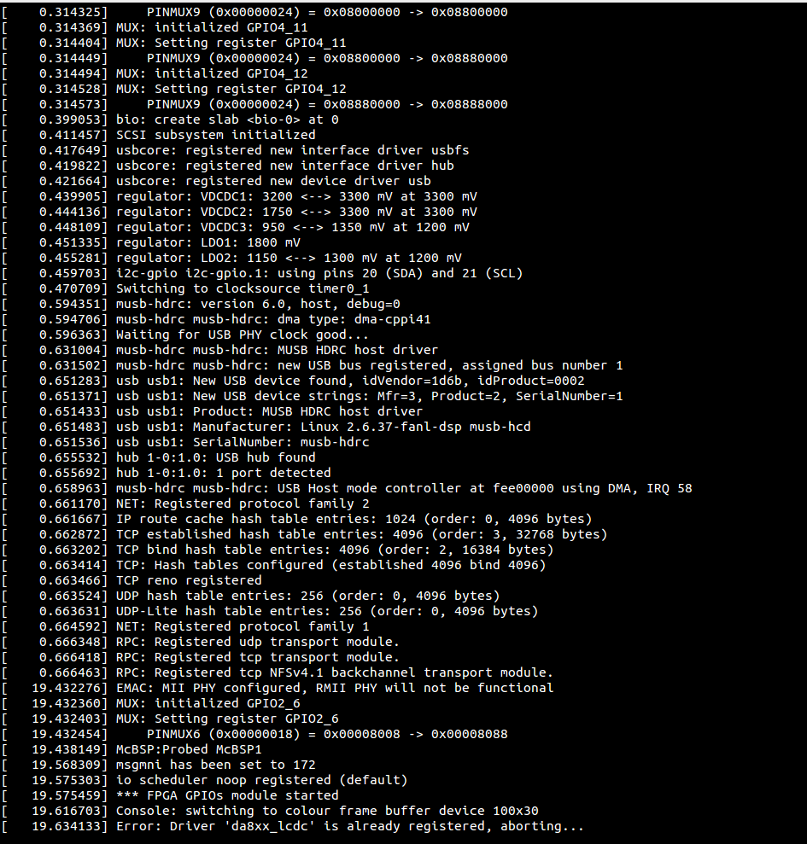

What is Linux?
An operating system (like windows)
Often used behind the scenes, but can still be used as a desktop
Sleek by nature, fast boot time
Open Source
Anybody can contribute to Linux
Pros and Cons?

Slide 4

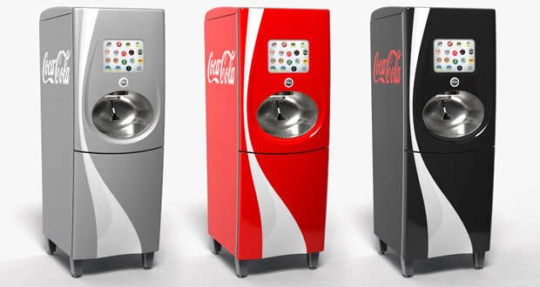
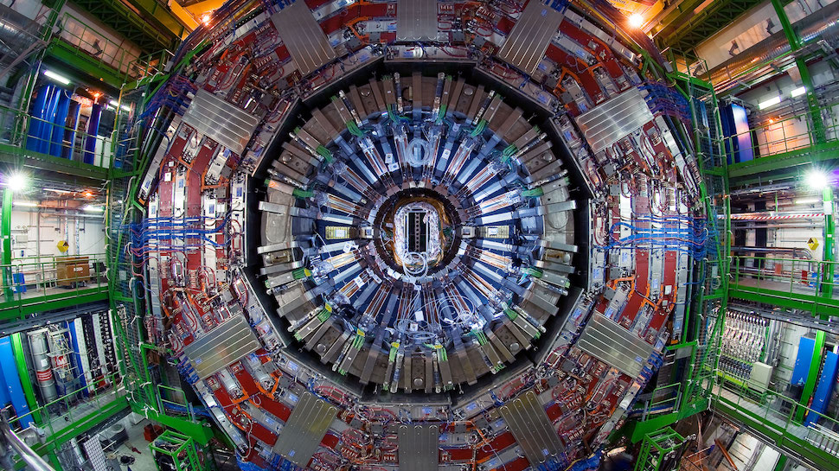
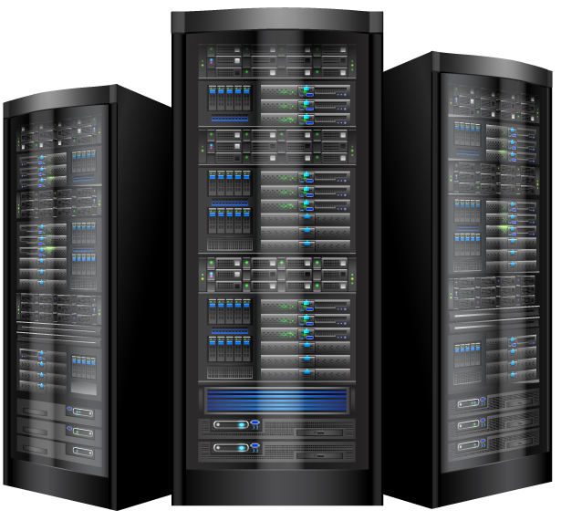



Where is Linux?

Slide 5
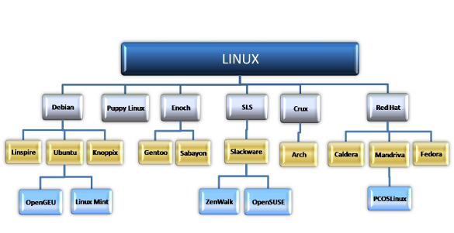
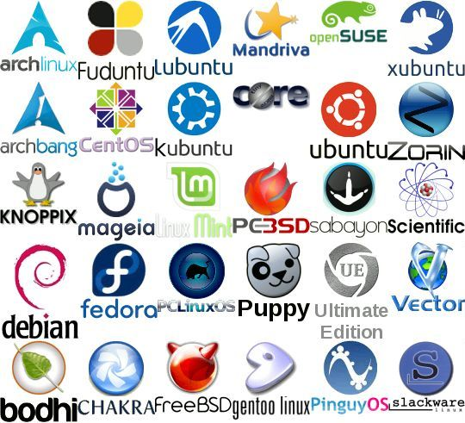
Different “flavors” of Linux

Slide 6
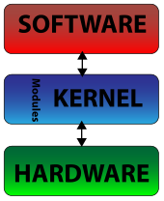
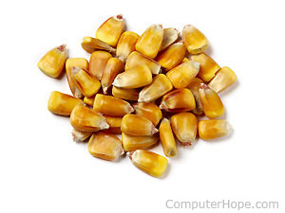
How does it work?
Linux is made up of a central component called the kernel that talks directly to hardware
Other programs run atop the kernel running as processes in the background (Updating filesystems, managing logins etc.)
These processes called “daemons” run silently and are not usually seen by the user

Slide 7
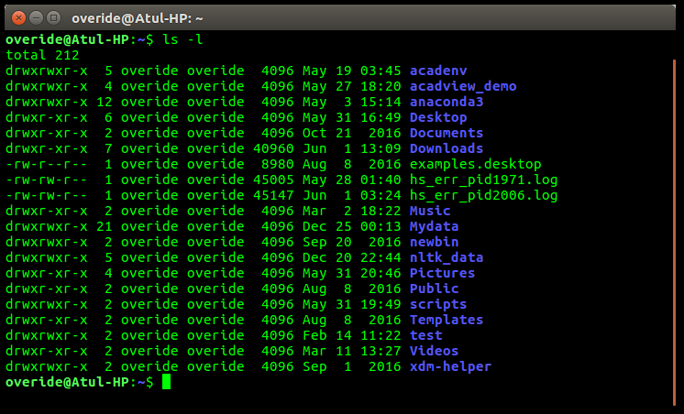
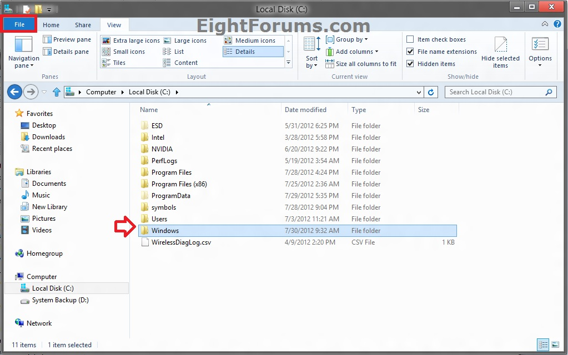


How do you talk to it?

Slide 8
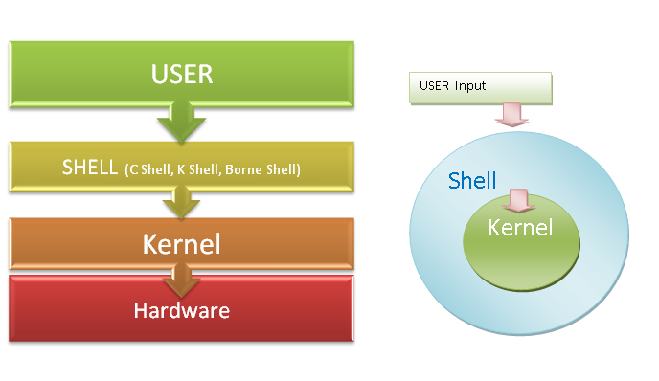
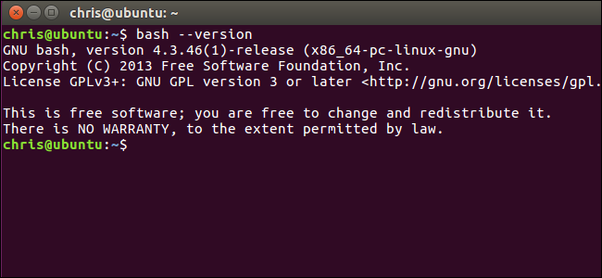
Shells

Slide 9
Linux: Unit 1
Section B

Slide 10
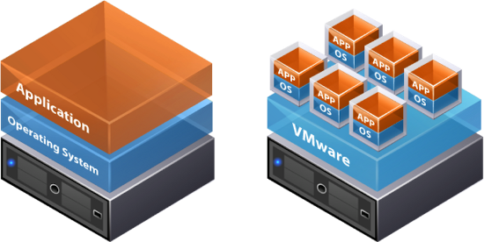

Virtual Machines

Slide 11
Accessing Images
Login to OnCampus
Navigate to the groups section and select Cyber
Navigate to the Topics Page
Click Beginners Linux
Beginner > Unit 1 > Linux_Module1 EXT.7zip
Download
Create a folder in C:\\Projects with your name, copy the zipped file there and extract

Slide 12
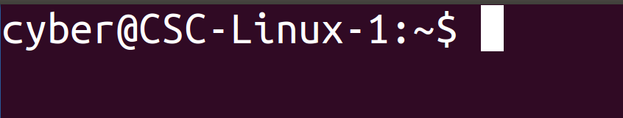

Slide 13
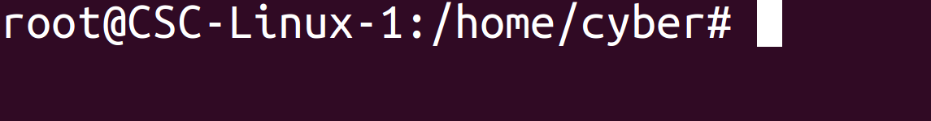
“God Mode” AKA root
The root account has unlimited access to the system
It is locked by default, why?
Problems of unlimited power?
Sudo

Slide 14
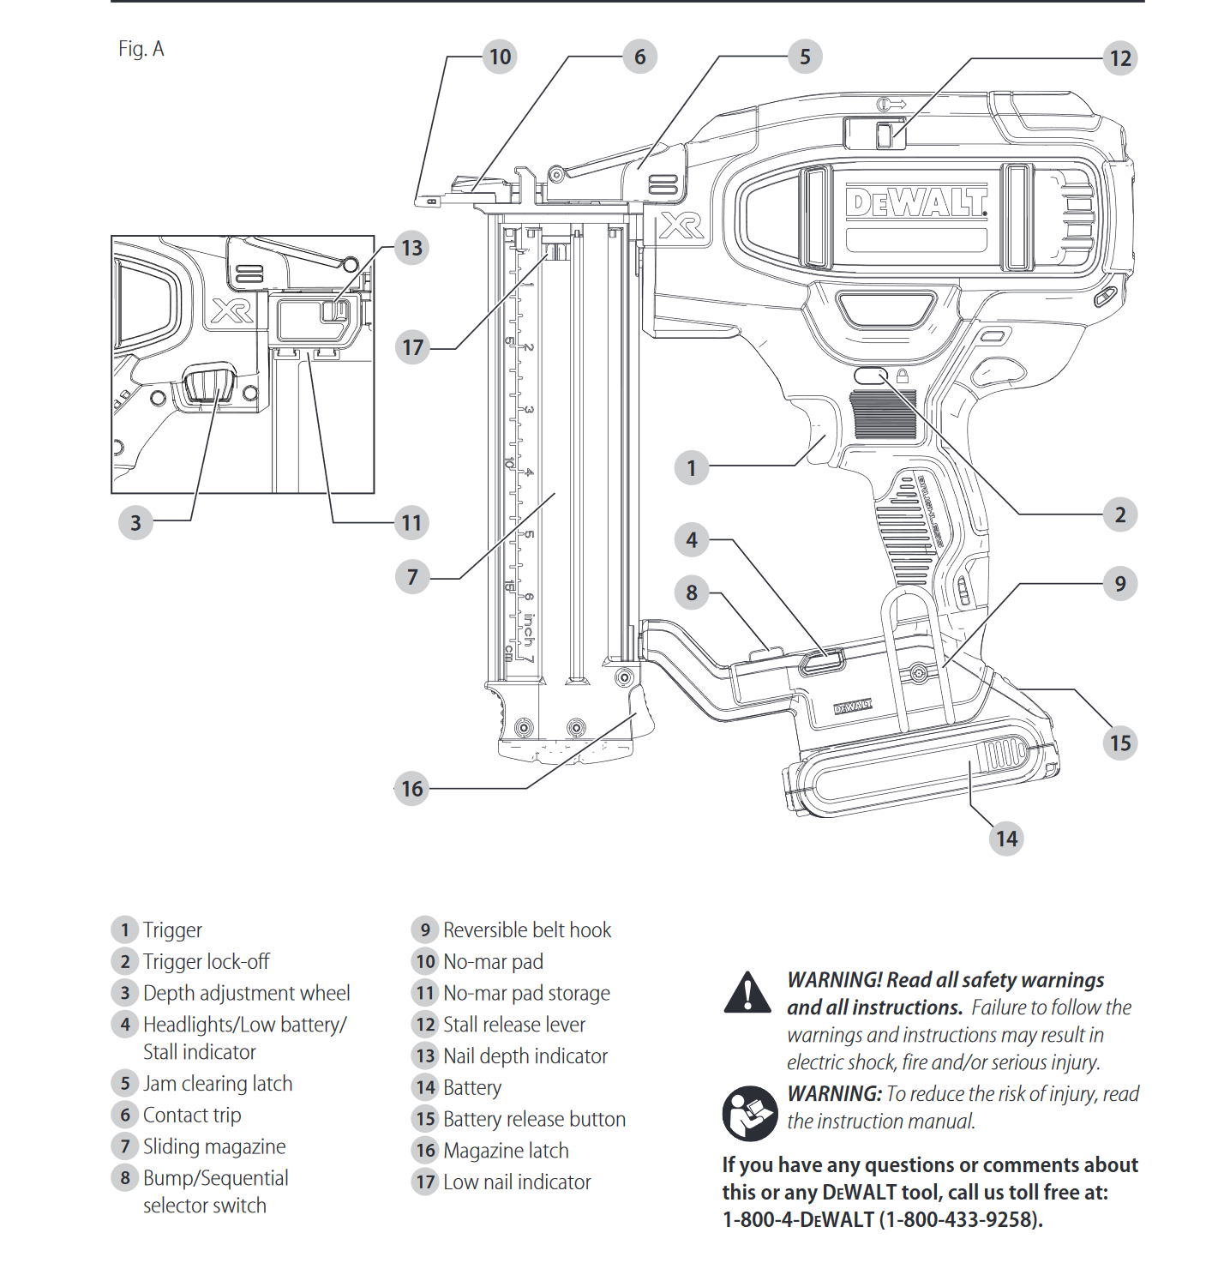

Slide 15
Quick things to remember
Case sensitive
Spaces are tricky
. is very shy

Slide 16
E/
Type pwd if you are lost
cd
ls
bin
var
etc
cd
ls
home
boot
tmp
lib
mnt
media
ls
cyber
Desktop
Documents
Downloads
Music
Pictures
Public
Templates
Videos

Slide 17

More than cd, ls and pwd
These three commands just help navigate the filesystem
command –options arguments

Slide 18
Files in Linux
touch
nano
rm
rmdir
mkdir

Slide 19

Files
What is a file?
How do you create a file or edit one on windows?

